Slide 1

Presented by:
Mohamed Magdy

Slide 2
What is Power BI?
BI tool Developed by Microsoft
Provide insights for business users
Connect to more than 100 data sources
Different Connectivity modes
- Data Transforming and modeling
Interactive Visualizations and reports
Data sharing

Slide 3


Slide 4
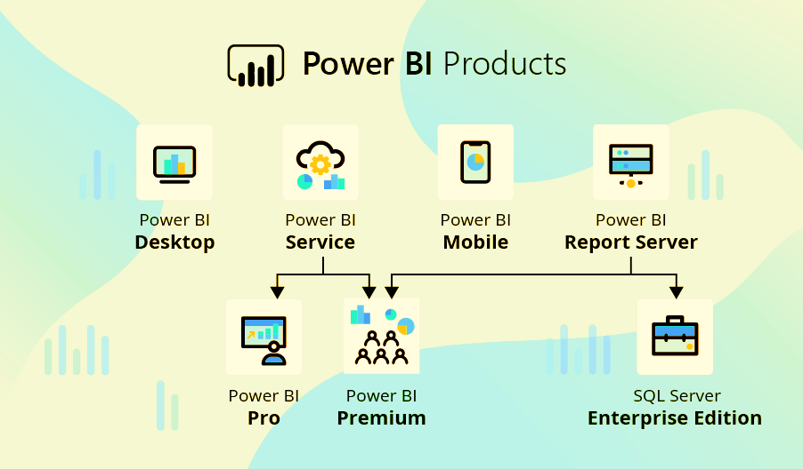

Slide 5
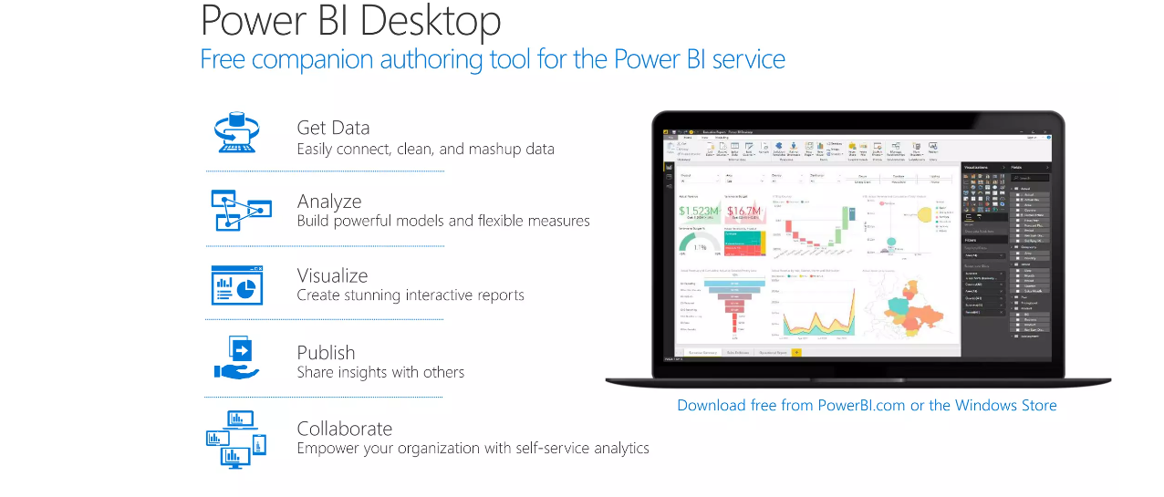

Slide 6
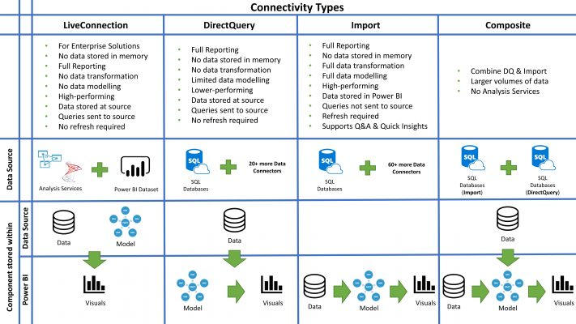

Slide 7
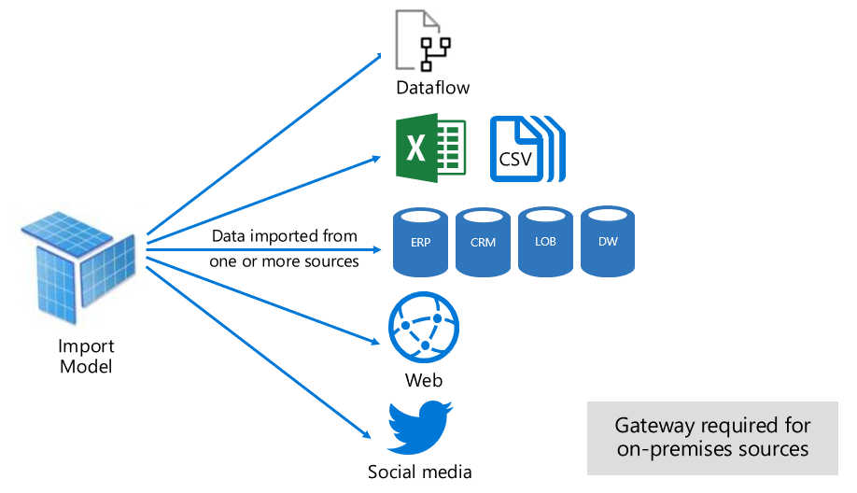

Slide 8
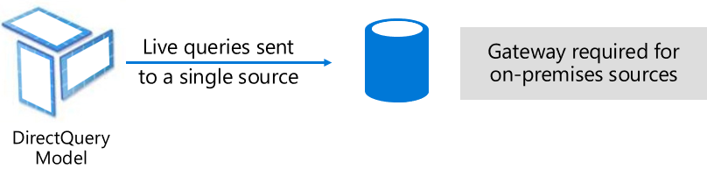

Slide 9
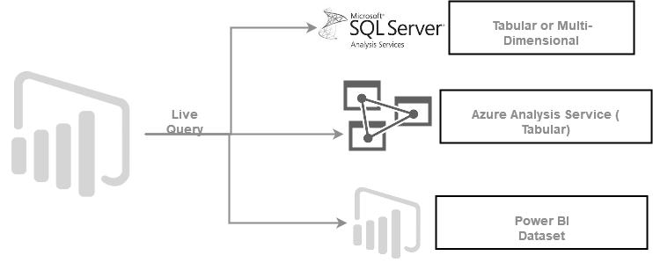

Slide 10
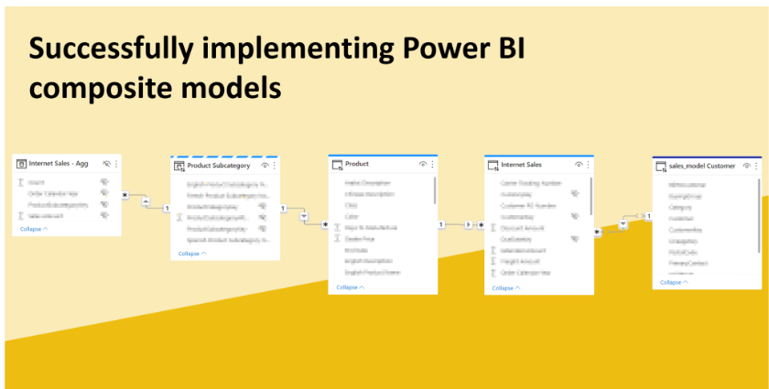

Slide 11
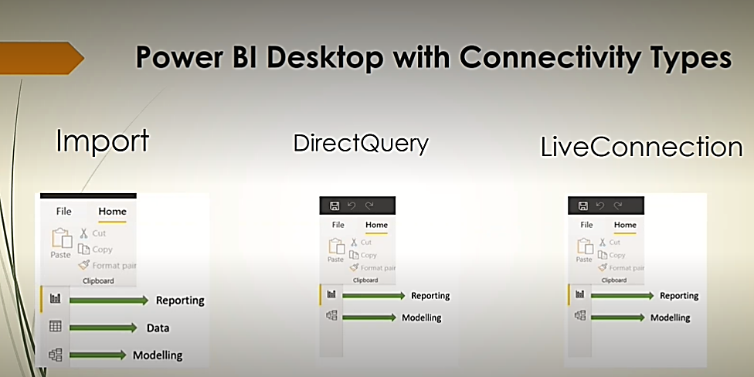

Slide 12


Slide 13
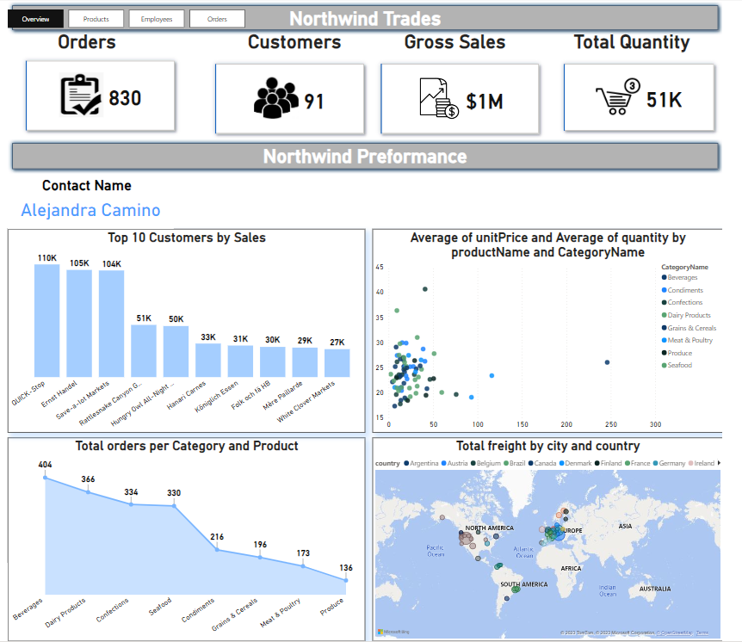

Slide 14
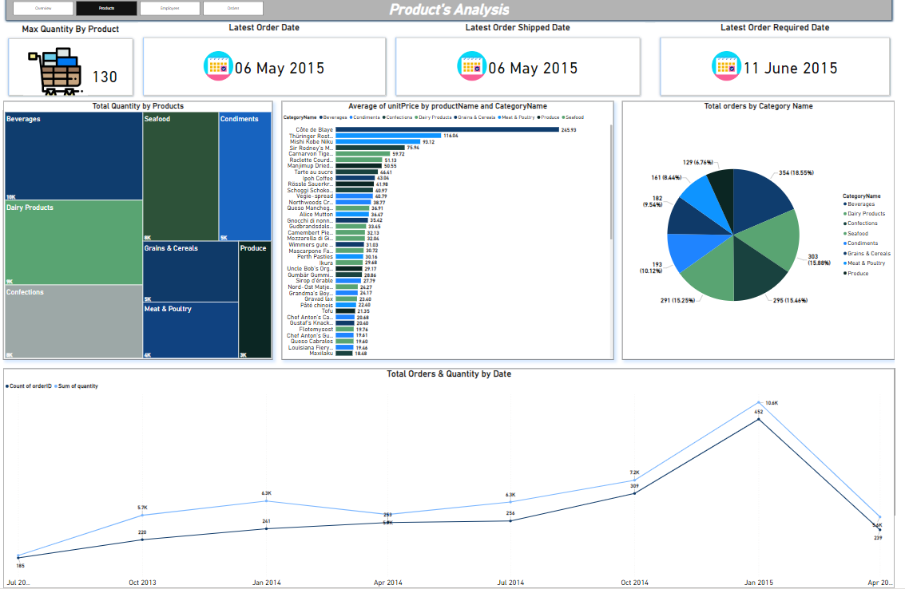

Slide 15
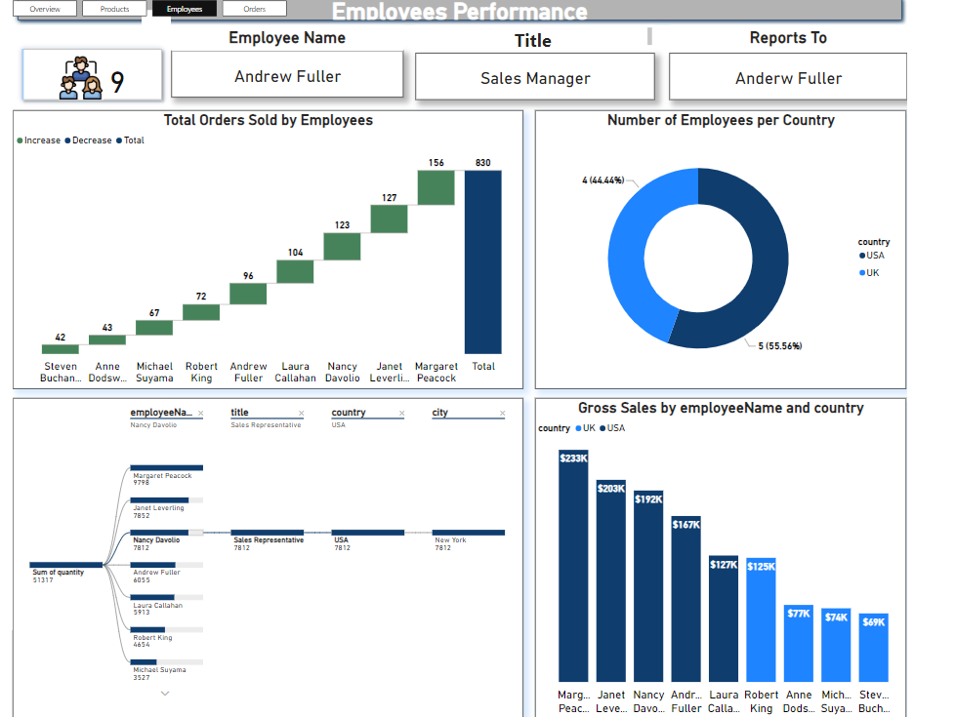

Slide 16
